Slide 1
Wii Nunchuck
By: Andrew Le

Slide 2
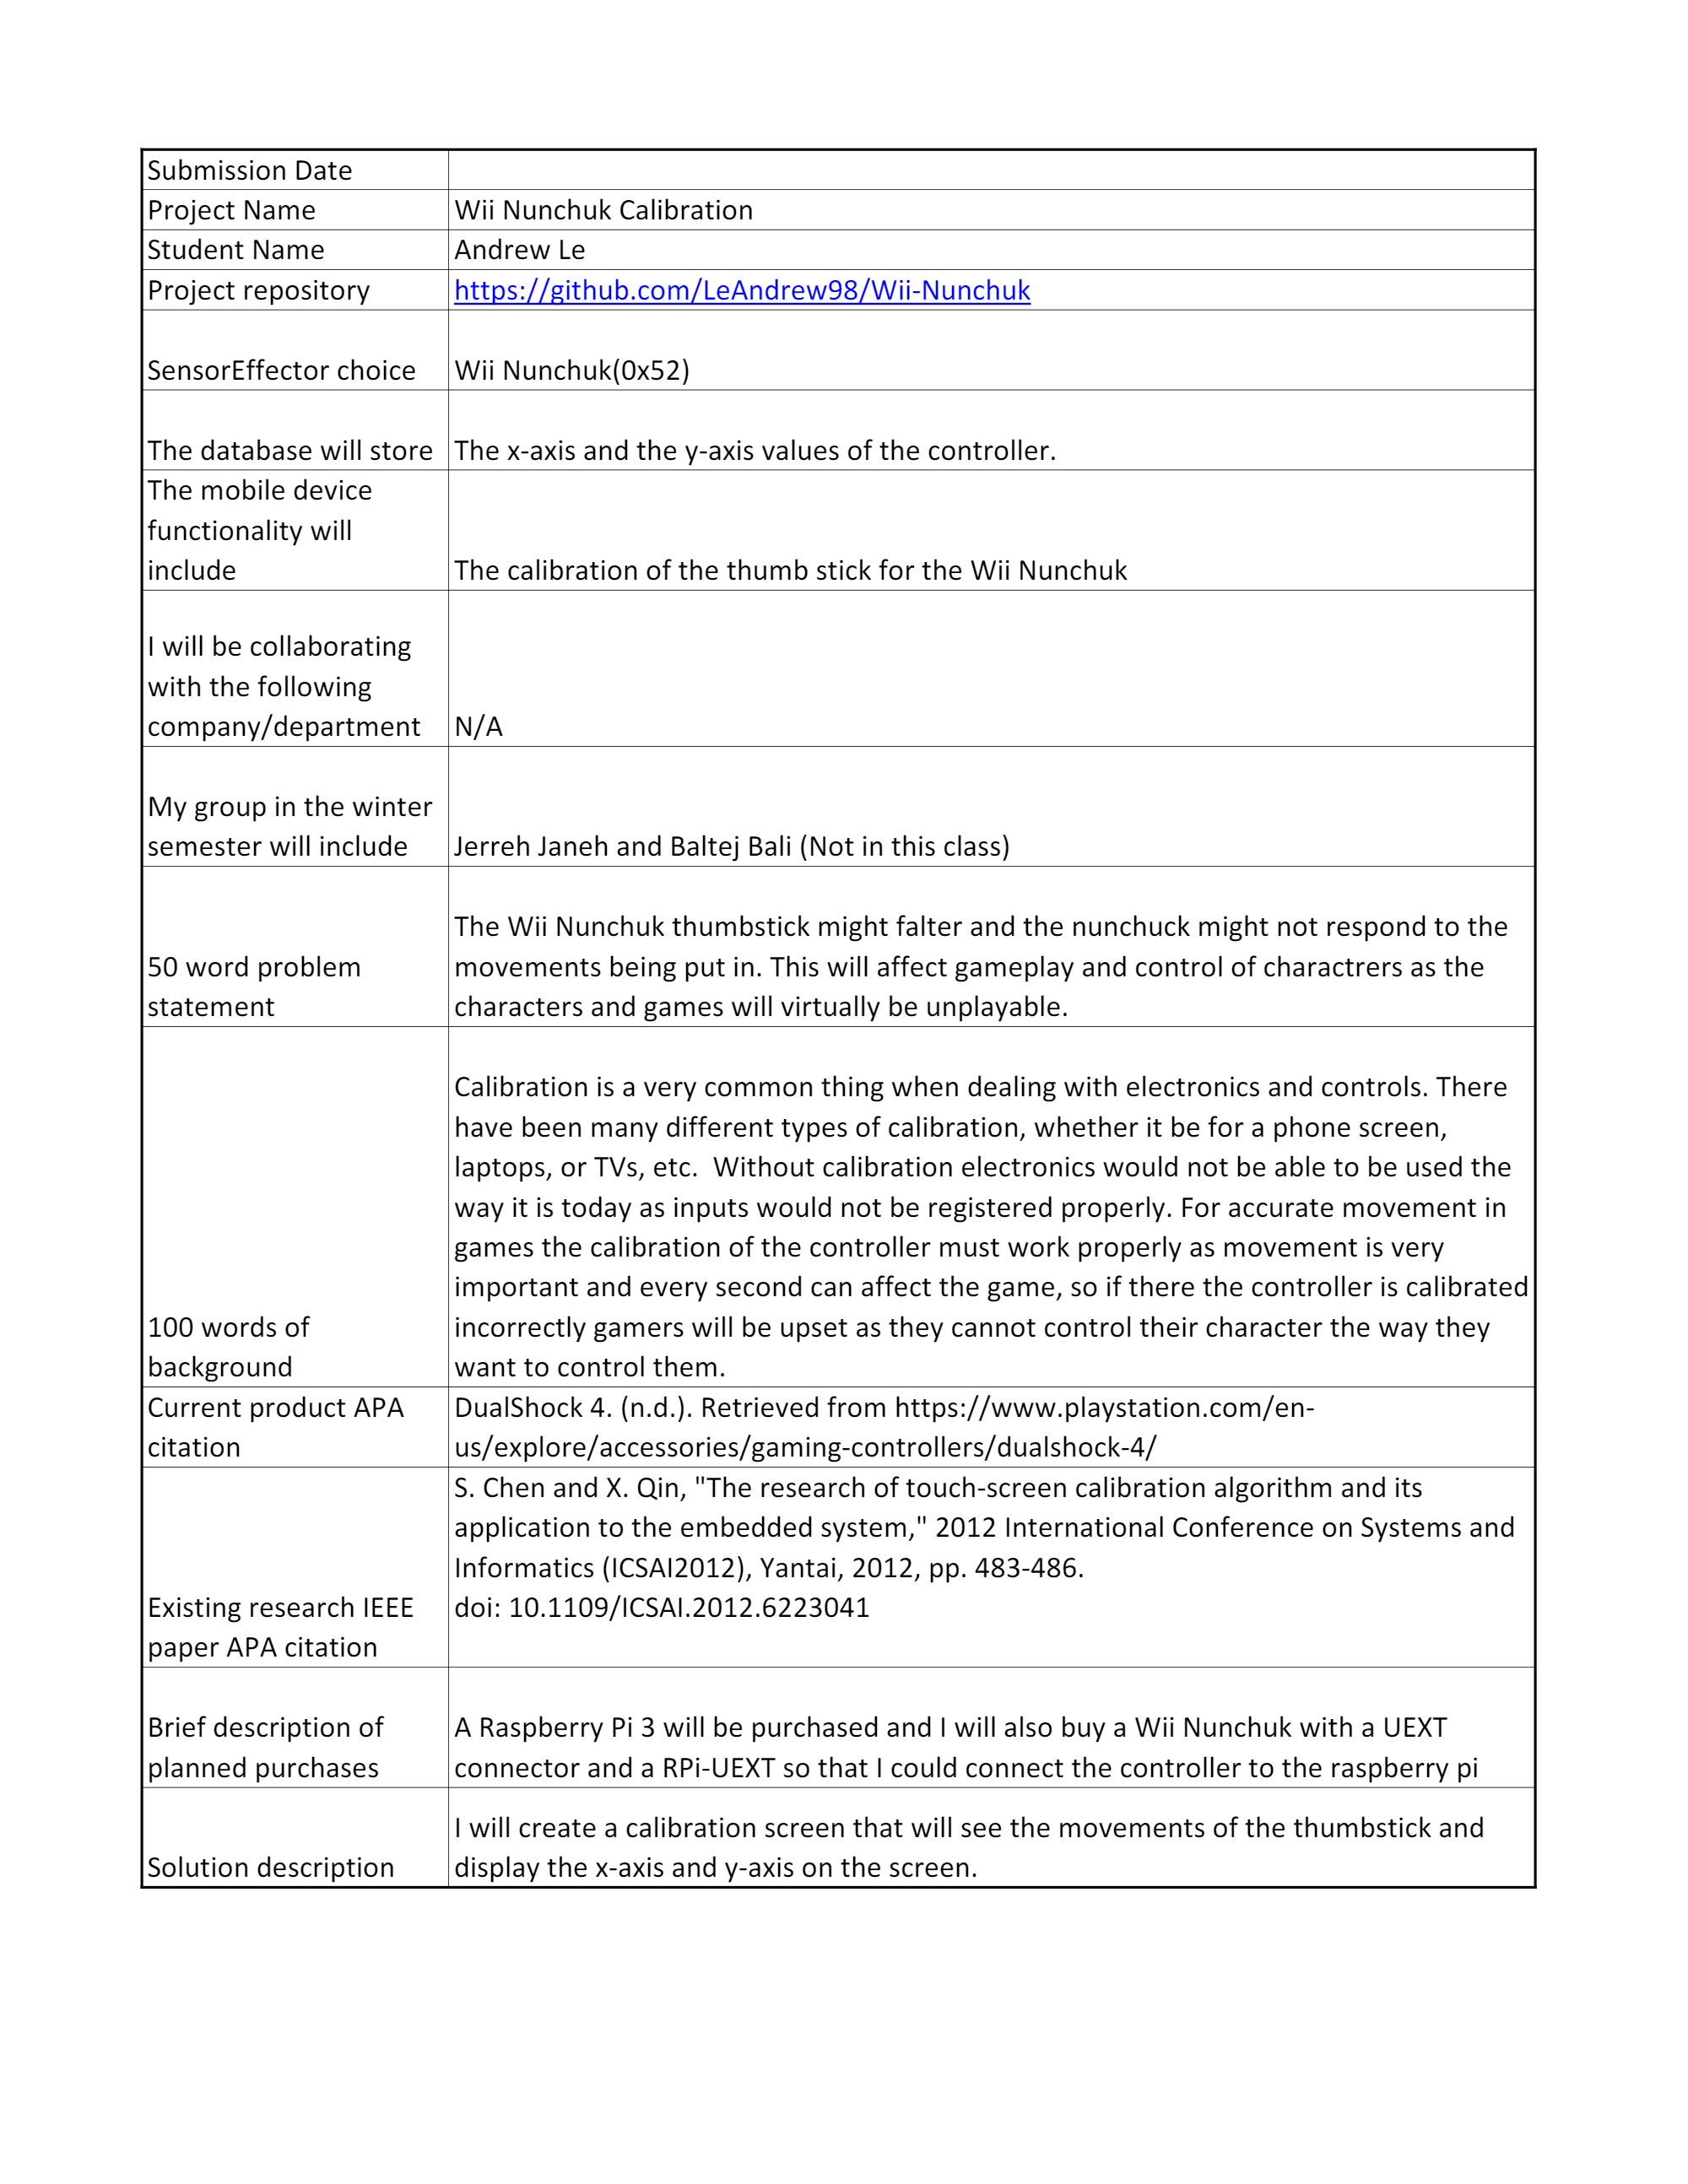
Proposal

Slide 3
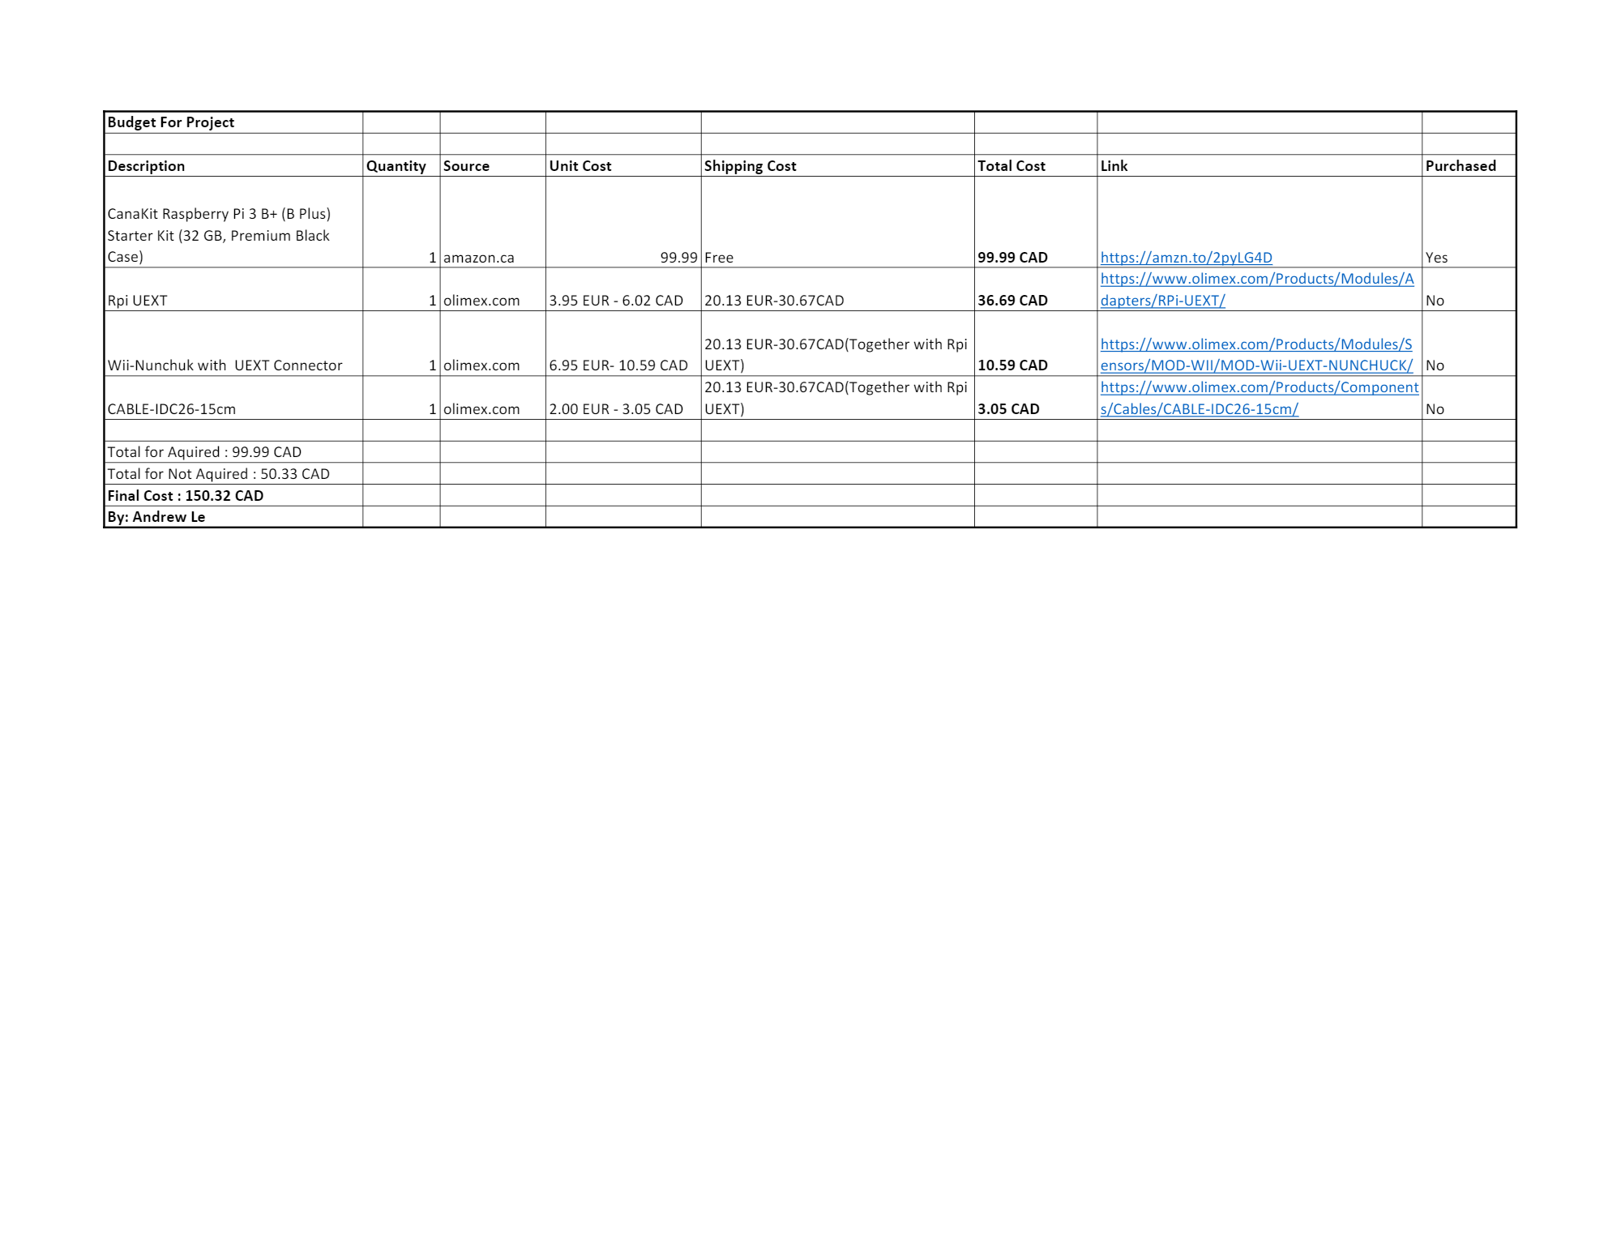
Budget
I need to update the budget to include wires that I had to buy after, the wires costed 18 dollars.

Slide 4
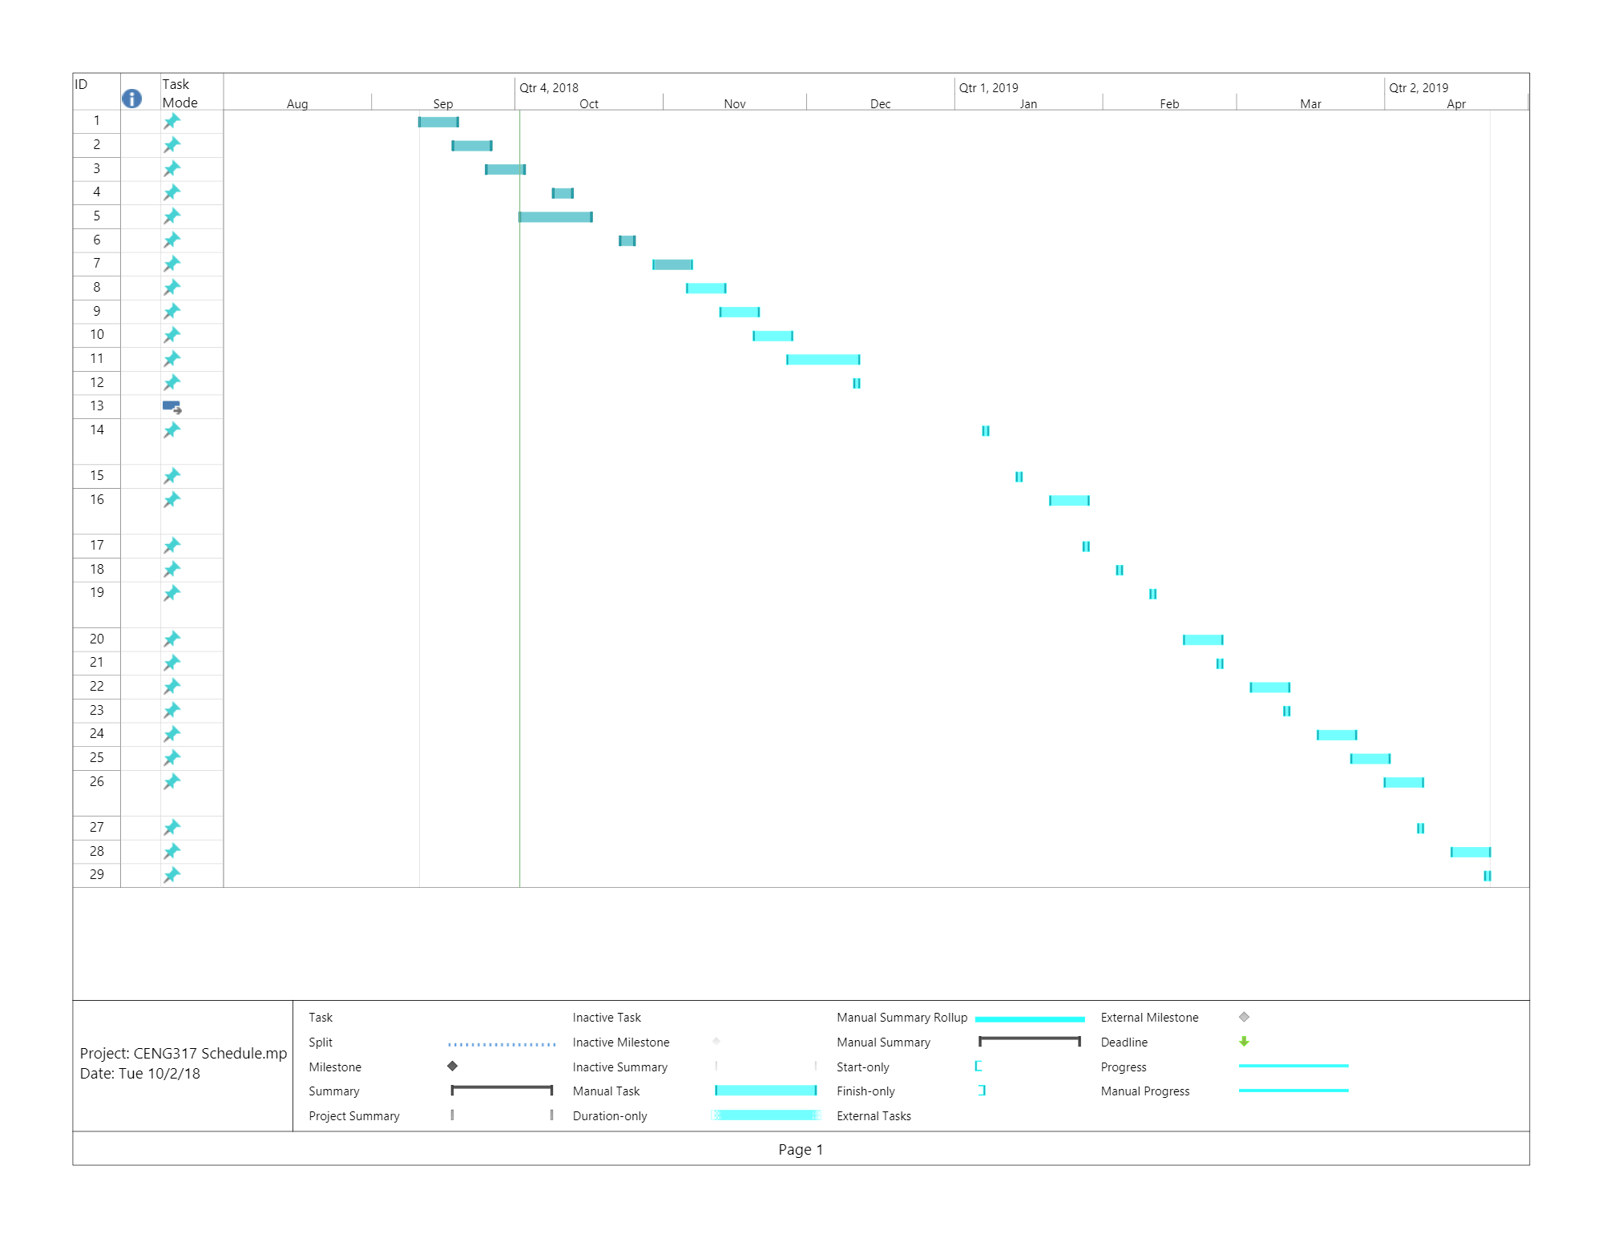
Schedule

Slide 5
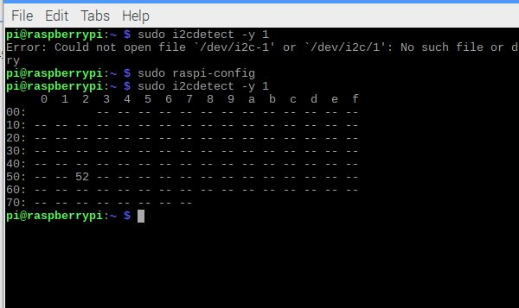
Address

Slide 6
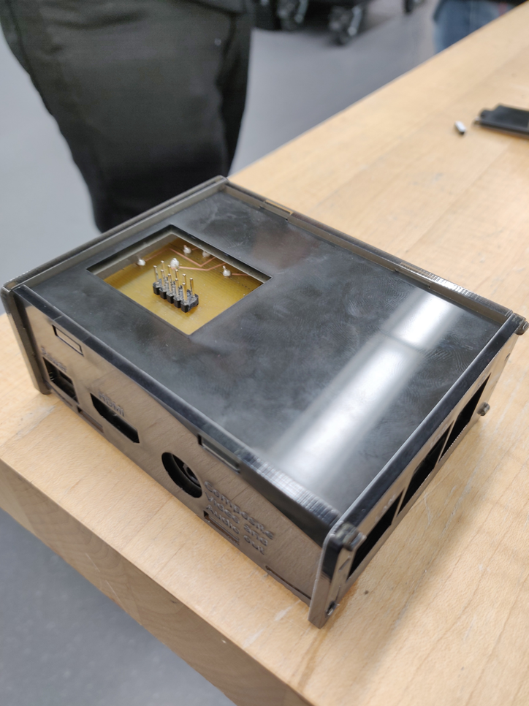
Enclosed Case

Slide 7
Past Courses
CENG200 – This class showed me how to navigate through Unix, with this I was able to know commands I needed and move through the terminal.
CENG252 – This class introduced me to sensors and how to use them, I used this knowledge for my own sensor.
WRIT220 – I used this class to help me in writing my proposal.

